Slide 1
April 15th
Abeta Clearance
Alpha secretase
Beta secretase

Slide 2
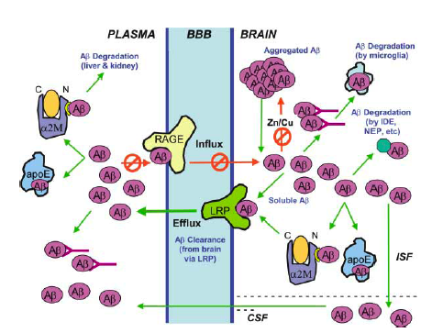
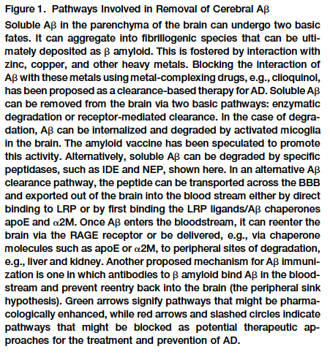
The many ways the system tries to get rid of the Abeta peptides

Slide 3
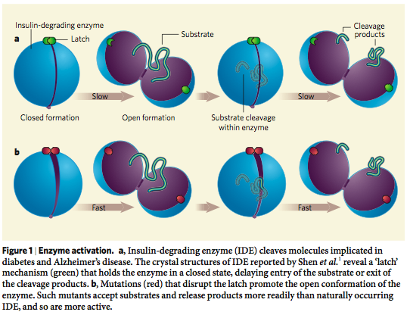
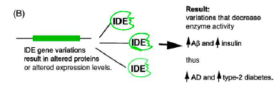
Insulin Degrading Enzyme (IDE) is crucial for Abeta degradation

Slide 4
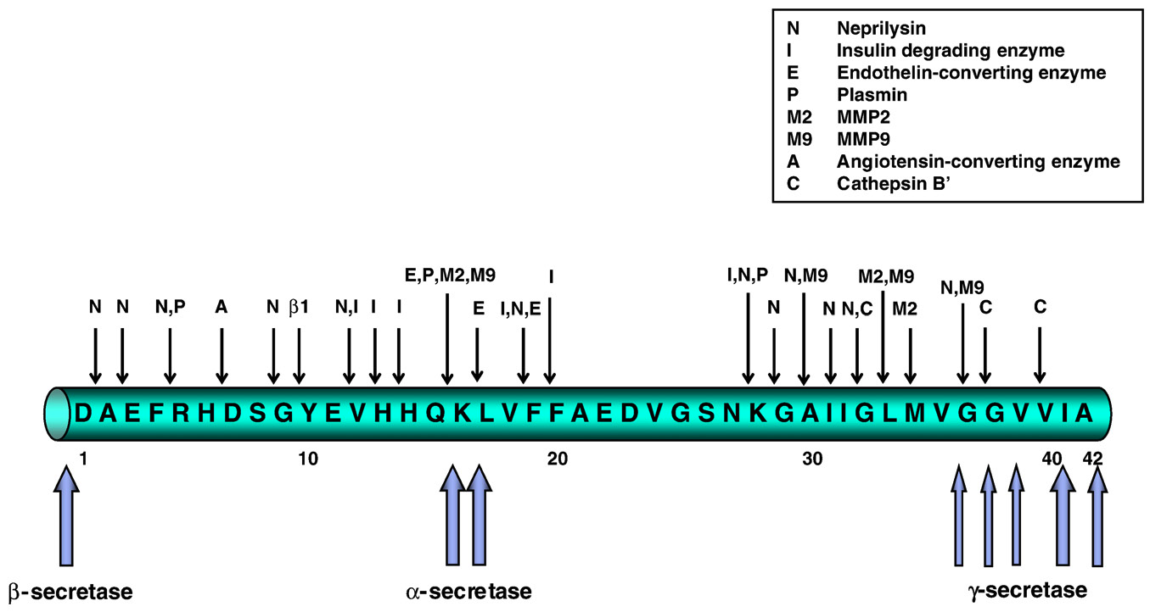
beta-Amyloid can be degraded at multiple sites

Slide 5
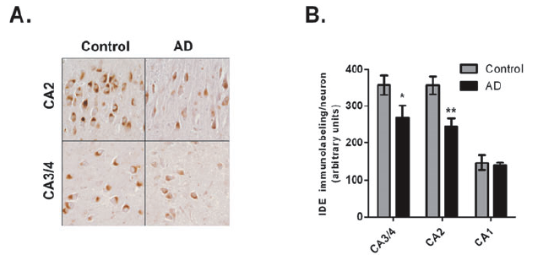
IDE levels are reduced in brain areas affected by AD

Slide 6
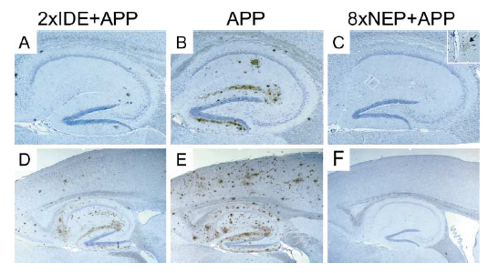
Decreased Aβ plaque burden in animals overexpressing
Insulin Degrading Enzyme (IDE) and Neprilysin
Leissring et al.,

Slide 7
Is there anything we can do to help the system get rid of the plaques or Abeta?
Y E S ! H E A L T H Y L I F E S T Y L E !!

Slide 8
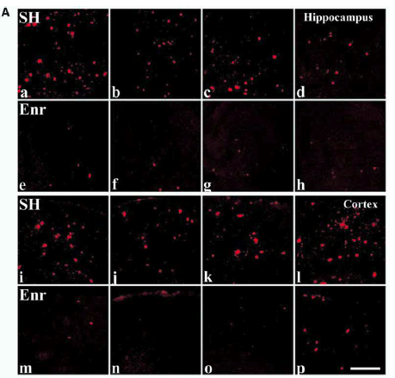
Abeta plaques are reduced in APPTg mice in enriched environment

Slide 9
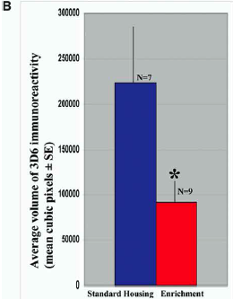
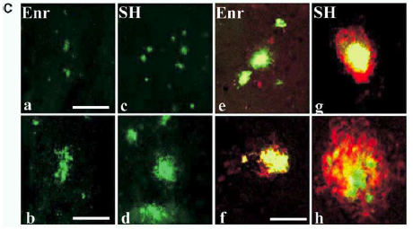
Abeta plaques are reduced in APPTg mice in enriched environment

Slide 10
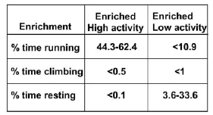
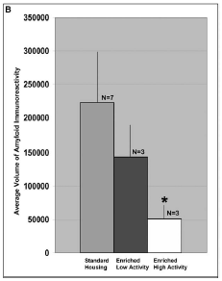
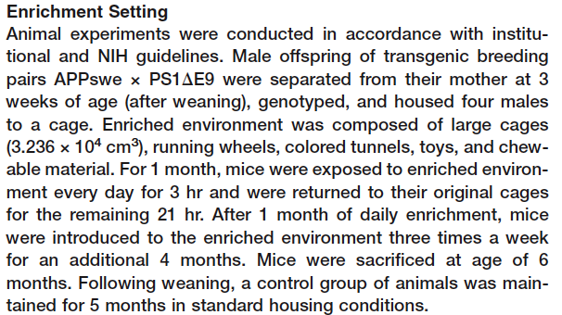
Environmental enrichment reduces the amyloid load

Slide 11
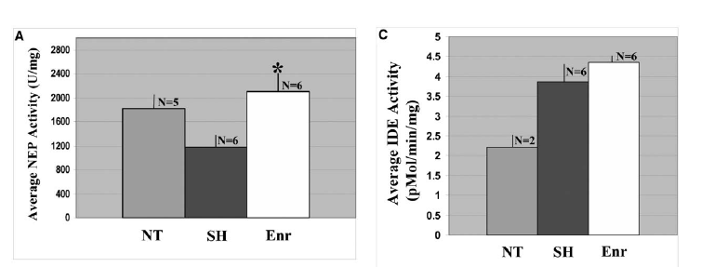
Activity of IDE and neprilysin are increased with environmental enrichment: Abeta clearance is favored

Slide 12
Intracellular trafficking of APP: relation to its physiological function?

Slide 13
Processing of APP
α-secretase
β-secretase
APP
TMD
NH2
COOH
sαAPPs
C83
C99
sβAPPs
γ-secretase
γ-secretase
Aβ
AICD
p3
AICD
Protective
non-amyloidogenic
pathway
Pathogenic
amyloidogenic
pathway

Slide 14
Why do we want to study the trafficking of APP?
Because the intracellular localization of APP INFLUENCES the production of β−Amyloid peptide

Slide 15
Intracellular compartments and processing of APP
α-secretase activity: in the plasma membrane (where metalloproteases, known to have like TACE and ADAM10/ADAM17, reside).
β-secretase activity: mostly in the endosomes, possible also in the ER and Golgi
γ-secretase activity: mostly in the ER, also in lysosomes and possible at the plasma membrane (still under debate).

Slide 16
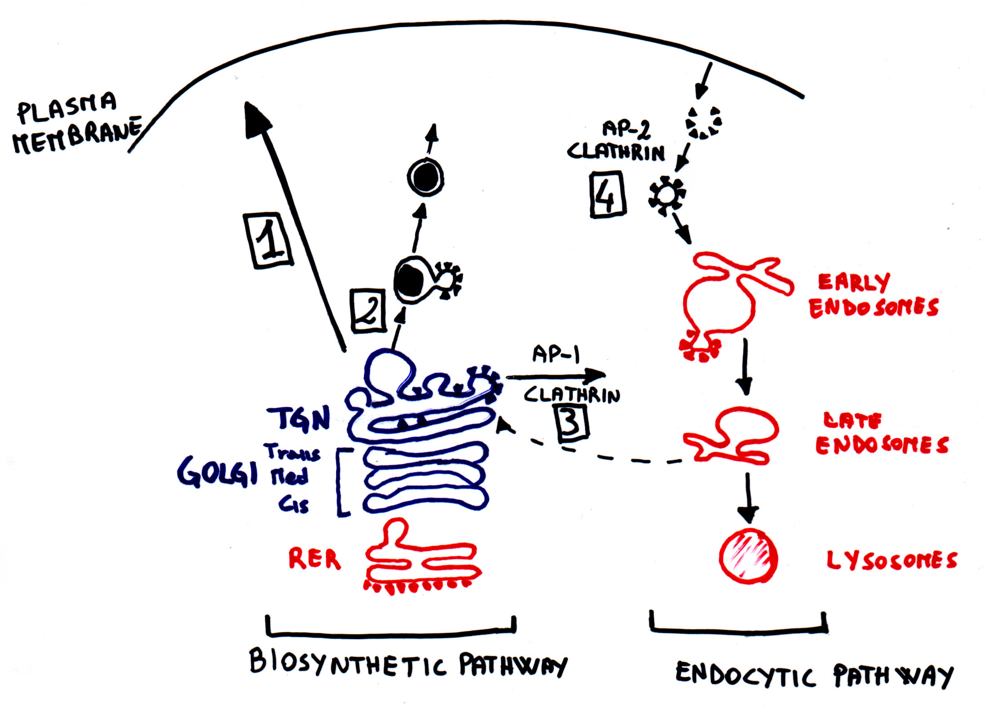
Protein trafficking and endocytosis

Slide 17
Trafficking of APP
APP
αAPP
α-secretase activity
APP
C83
β-secretase activity
C99
βAPPs
C99
AICD
γ-secretase activity
Aβ

Slide 18
APP retained @ plasma membrane =
Internalization of full length APP =
GOOD!!
☺
Protective non-amyloidogenic processing
BAD!!!
☹
pathogenic amyloidogenic processing

Slide 19
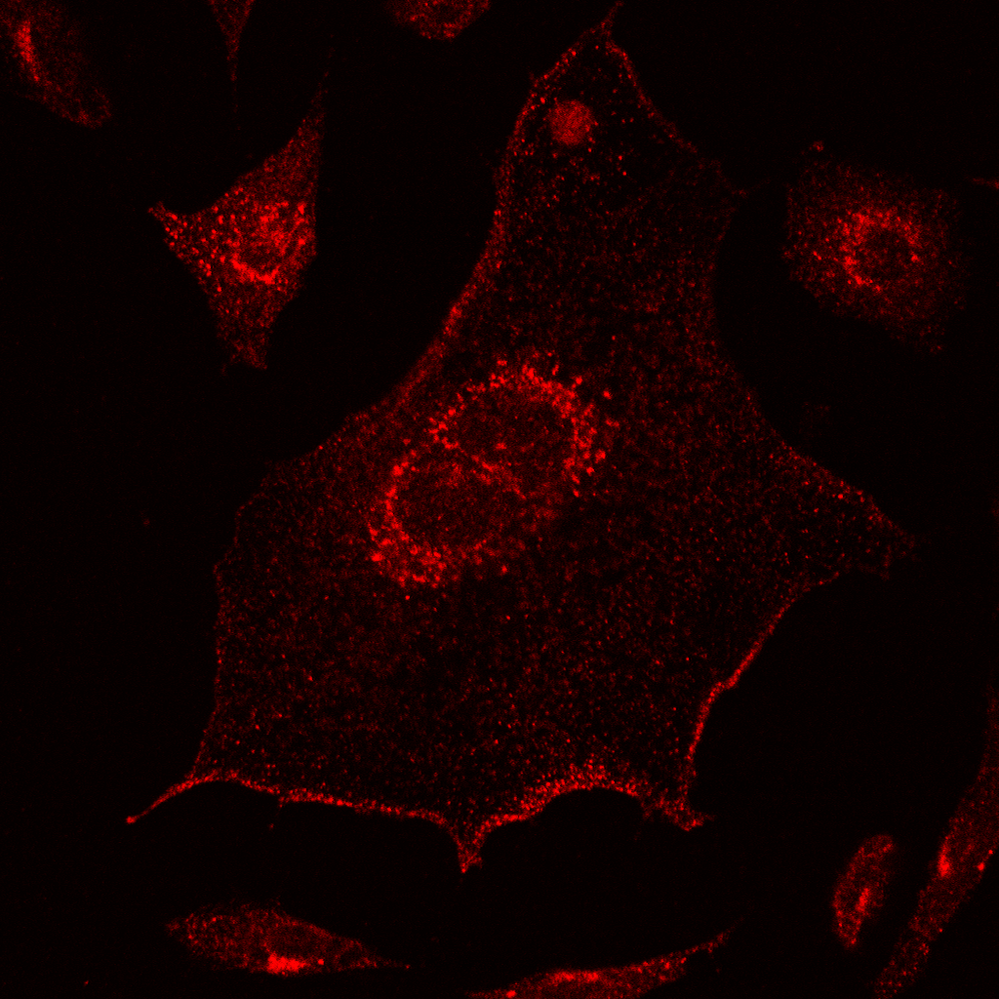
APP localizes to the plasma membrane, Golgi and endosomes
APP
TMD
5A3/1G7
NH₂
Pastorino, JAD 2012

Slide 20
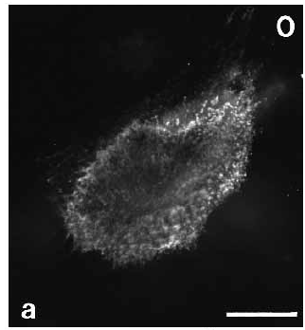
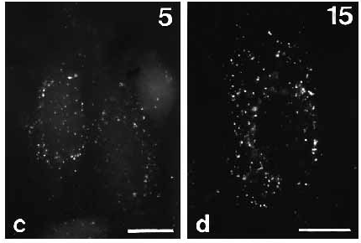
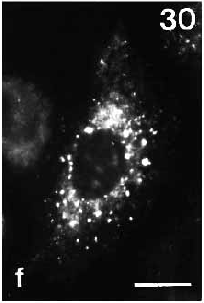
APP internalizes from the plasma membrane into intracellular compartments, endosomes and Golgi
APP
TMD
5A3/1G7
NH₂
COOH
Koo and Squazzo, 1994

Slide 21
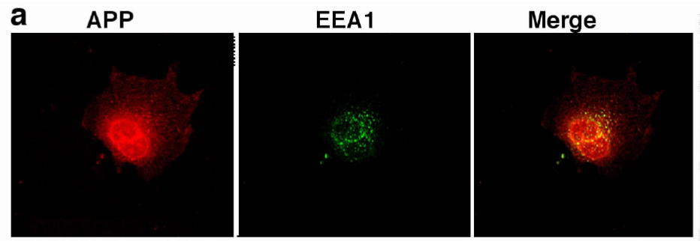
APP co-localizes with the endosomes
Pastorino et al., 2006

Slide 22
Products dowstream of non-amyloidogenic processing:
αAPPs: soluble stub of APP deriving from the α-secretase cleavage :
possible neurotrophic function
p3: c-terminal truncated portion of the sequence of b-amyloid, deriving from the subsequent action of α- and γ-secretase. DOES NOT aggregate. Unknown function.
AICD: APP Intra Cellular Domain, deriving from the cleavage of γ-secretase. Known regulation of transcriptional activity.

Slide 23
Products downstream of the amyloidogenic processing:
βAPPs: soluble stub of APP deriving from the β-secretase cleavage : unknown function
C99: c-terminal stub containing the entire intact sequence of the β-amyloid peptide, deriving from the action of β-secretase. It is the substrate from where β-amyloid peptides derive.
β-Amyloid peptides: generated by the subsequent action of β- and γ-secretases. At very low concentration could be neurotrophic, however, when forming aggregates they are VERY TOXIC and lead to the formation of the core of the β-amyloid plaque in AD
AICD: APP Intra Cellular Domain, deriving from the cleavage of γ-secretase. Known regulation of transcriptional activity.

Slide 24
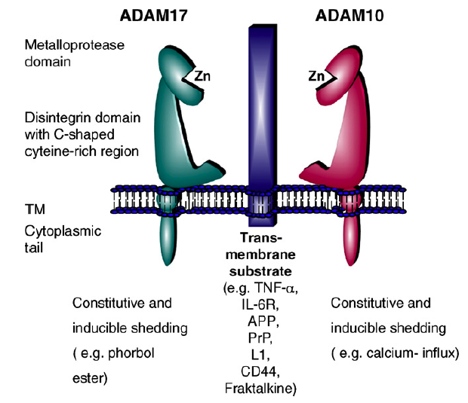
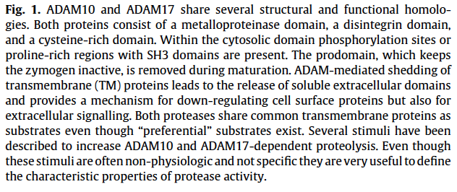
Alpha-secretase: ADAM10, ADAM17, TACE
notch

Slide 25
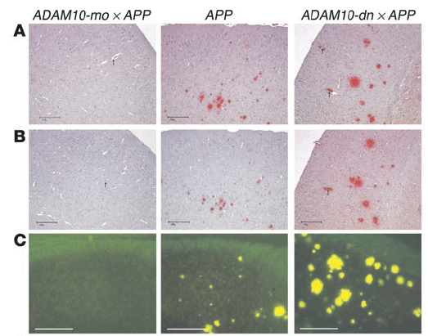
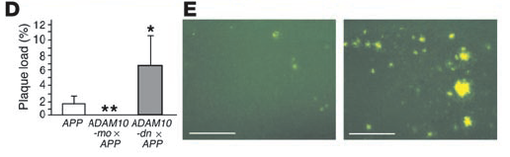
ADAM10 protects from plaque deposition
in APPTg V717I (Indiana) mice…
10 months old

Slide 26
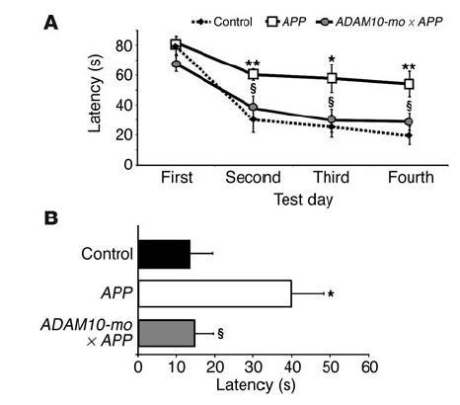
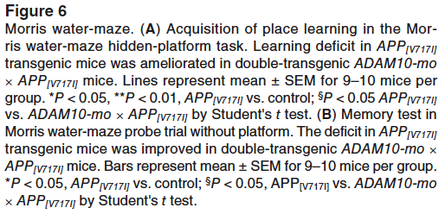
Overexpression of ADAM10 in double transgenic mice
ADAM10 X APPV717I rescues behavioral impairment

Slide 27
Could ADAM10 levels decrease during aging causing AD?

Slide 28
Loss of non-amyloidogenic activity as a possible way to develop AD?

Slide 29
Shifting the Balance between Amyloidogenic and non-Amyloidogenic Processing: A reason for AD?
ADAM10mut
APPmut
PS1 Mut
ADAM10WT
non-amyloidogenic
processing
amyloidogenic
processing
amyloidogenic
processing
non-amyloidogenic
processing

Slide 30
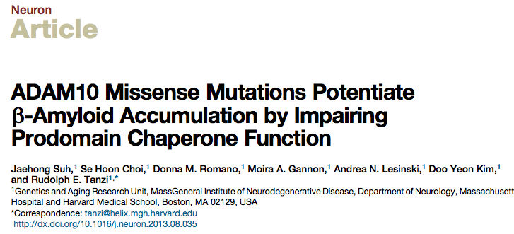

Slide 31
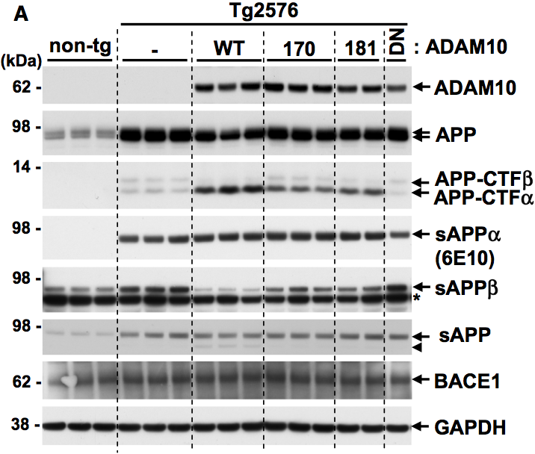
ADAM 10 LOAD mutations and APP processing in AD mice:
Not too good, not too bad

Slide 32
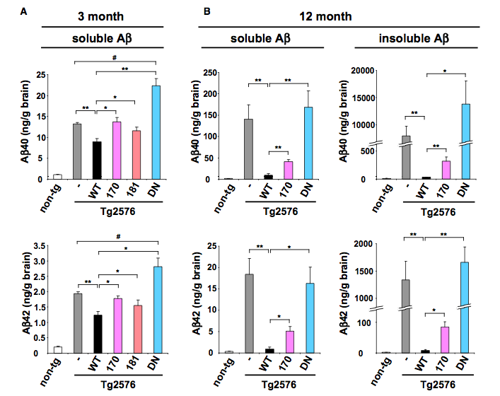
ADAM 10 LOAD mutations affect Aβ production in AD mice

Slide 33
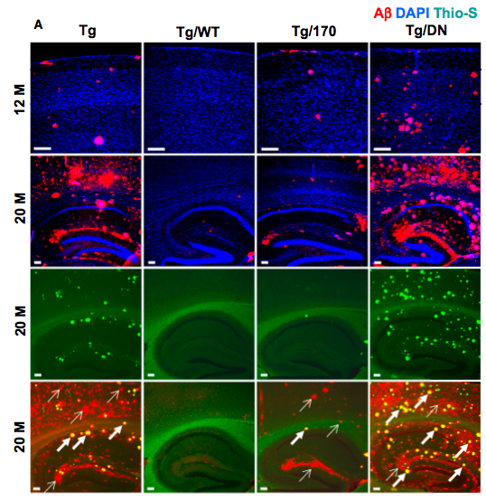
ADAM 10 LOAD mutations affect plaque deposition in AD mice

Slide 34
ADAM 10 LOAD mutations shift the balance between non-amyloidogenic and amyloidgenic APP processing

Slide 35
The aspartyl protease BACE
β-Amyloid cleaving enzyme

Slide 36
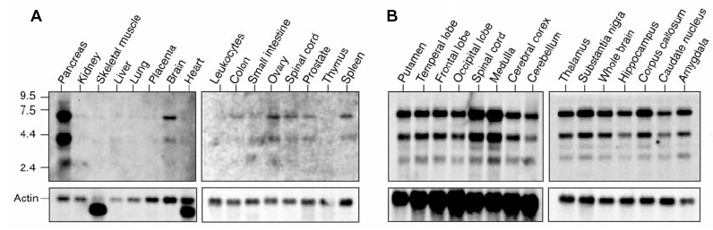
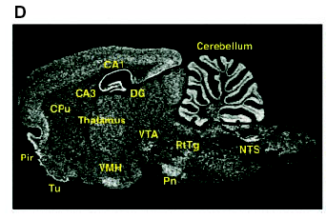
BACE is expressed mostly in the brain
Vassar et al., 1999

Slide 37
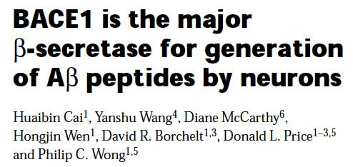

Slide 38
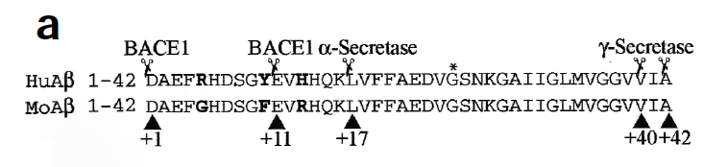
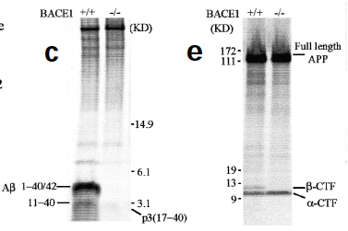
BACE KO mice lack amyloidgenic processing of APP

Slide 39
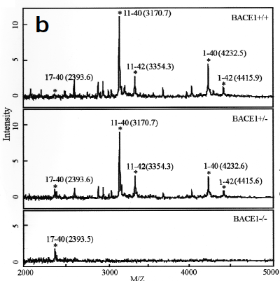
Abeta levels are reduced in BACE KO mice

Slide 40
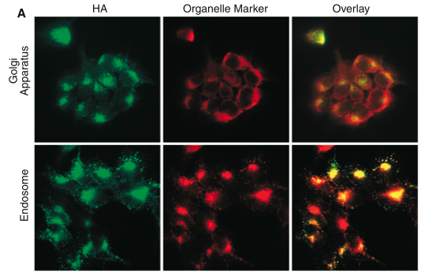
In the cell, BACE localizes to Golgi apparatus and Endosomes
Vassar et al., 1999

Slide 41
BACE Domains and trafficking
1
aa460-476
501
Propeptide
sequence
DTG
DSG
TM
furin
DDISLLK
Regulation of BACE Trafficking
Abeta?

Slide 42
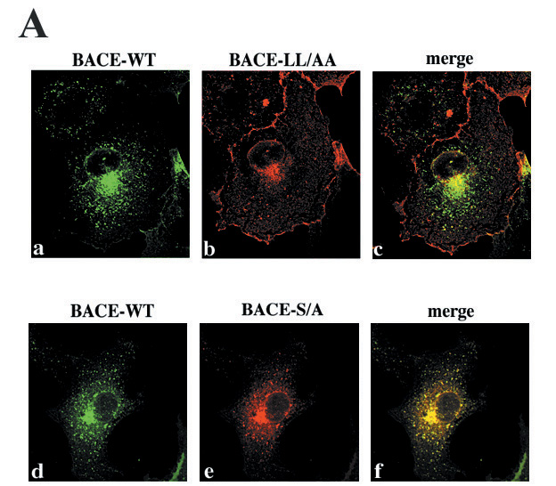
The LL motif, but not the S (that can be phoshorylated) regulates the amount of BACE retained at the plasma membrane…..
Pastorino et al., MCN 2002

Slide 43
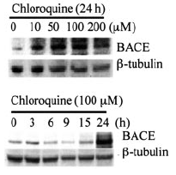
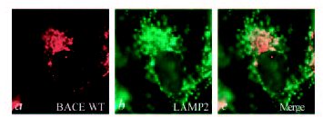
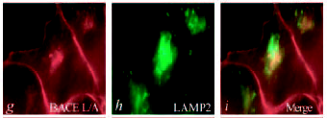
BACE LL motif determines lysosomal colocalization
for degradation
Koh et al., 2005

Slide 44
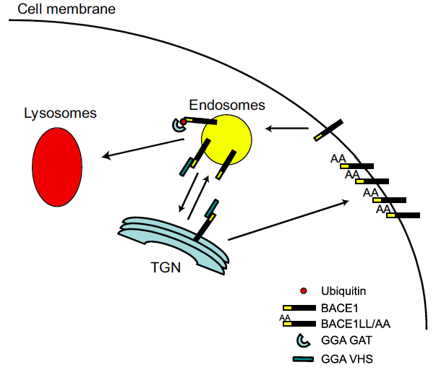
GGA proteins: a crucial role in the regulation
of BACE trafficking and degradation through BACE LL domain

Slide 45
Do GGA3 and BACE levels change during neurodegenerative pathologies?

Slide 46
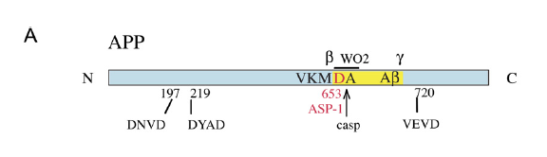
APP contains caspase cleavage sites in its sequence
Tesco et al., Neuron. 2007 Jun 7;54(5):721-37.
However, although apoptosis increases C99 and Aβ levels, this effects do not depend on caspase-mediated cleavage of APP (Tesco et al., 2003).

Slide 47
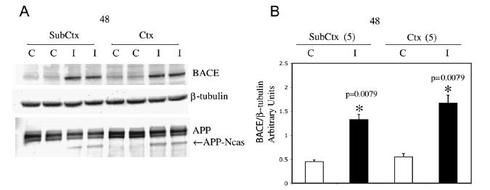
Ischemic patients have increased levels of BACE
in the brain…
Tesco et al., Neuron. 2007 Jun 7;54(5):721-37.

Slide 48
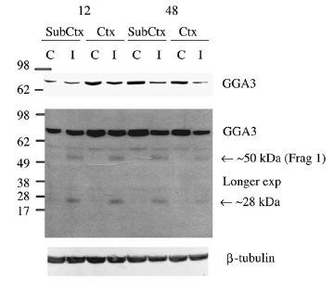
…and decreased levels of GGA3
Tesco et al., Neuron. 2007 Jun 7;54(5):721-37.

Slide 49
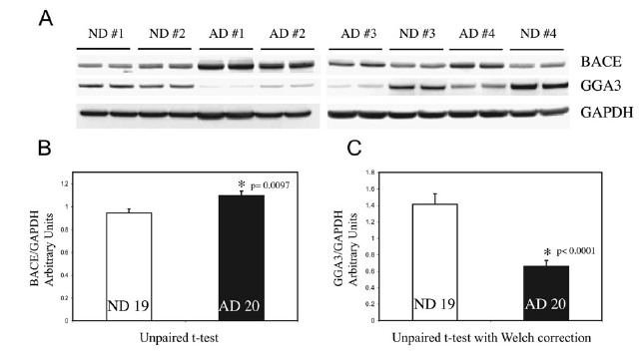
AD patients have increased levels of BACE
and decreased levels of GGA3 in the brain…
Tesco et al., Neuron. 2007 Jun 7;54(5):721-37.

Slide 50
What happens during apoptosis?

Slide 51
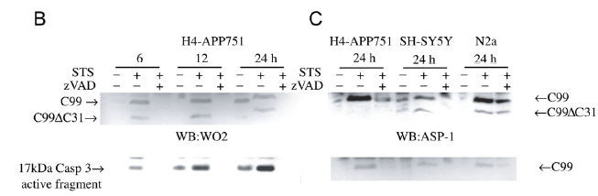
Apoptosis increases levels of C99…..
Tesco et al., Neuron. 2007 Jun 7;54(5):721-37.

Slide 52
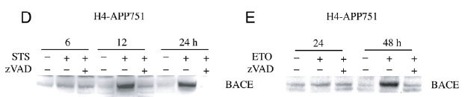
…and BACE
Tesco et al., Neuron. 2007 Jun 7;54(5):721-37.

Slide 53
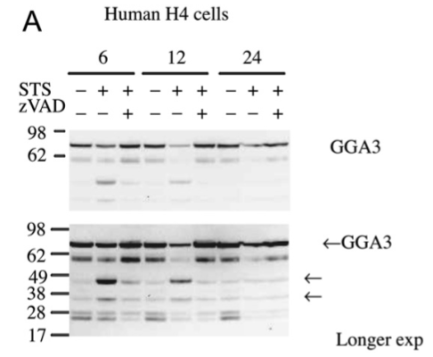
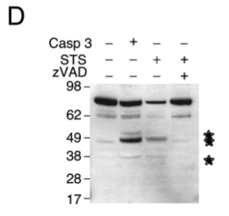
During apoptosis GGA3 levels are destabilized
Tesco et al., Neuron. 2007 Jun 7;54(5):721-37.

Slide 54



GGA3 siRNA causes increase of BACE expression
and accumulation of C99
Tesco et al., Neuron. 2007 Jun 7;54(5):721-37.

Slide 55
Apoptotic mechanisms associated with neurodegeneration stabilize BACE via the inhibition of GGA3, therefore inhibiting GGA3-mediated BACE degradation

Slide 56

Model of BACE stabilization during apoptosis
Vassar, Neuron. 2007 Jun 7;54(5):671-3. Review.

